Slide 1
Developing and Deploying Containers and Microservices with Azure Container Apps
Will Velida
Engineer @ Microsoft
@willvelida
Notes:
Hi everyone! How are we all? How’s techorama going far?
My name is Will, welcome to this session on Developing and deploying containers and microservices with Azure Container Apps (rolls off the tongue right?)

Slide 2
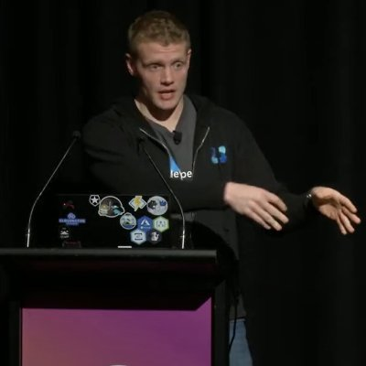
About Me
Customer Engineer for Microsoft based in Auckland, New Zealand.
Previously Software Engineer and Cloud Architect for 5 years before joining MSFT (Banking, Health and Agricultural).
Previously a Data Platform MVP (Cosmos DB), now focused on Cloud Native App Dev.

Slide 3
A word on microservices + K8s before we start
Do you need microservices?
Do you need Kubernetes?
Should you use Kubernetes and Microservices for everything?

Slide 4
No

Slide 5
Agenda
What are Azure Container Apps?
What can we build with it?
Deep Dive into Container Apps
Demos!
QnA
Notes:
So today we’ll start by going over what Container Apps is at a high level and what kind of applications we can build with Container Apps.
We’ll then take a quick deep dive into the features of Container Apps and how we can use them when we’re building applications for Container Apps.
I’ve got a couple of demos, where I’ll show you different ways we can provision Container Apps and how we deploy our containerized workloads to them. We’ll then finish off with some QnA.
Let’s dive in!

Slide 6
What are Azure Container Apps?

Slide 7
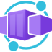
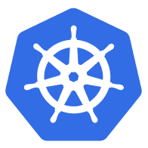



Azure Container Apps
Serverless containers for microservices
Build modern apps on open source
Focus on apps, not infrastructure
Scale dynamically based on events
Builds on Kubernetes, providing a fully managed and optimized environment
Kubernetes
KEDA
DAPR
Envoy
Notes:
Let’s start with a high level overview of Azure Container Apps.
Kubernetes is hard! We’re constantly seeing customers citing Kubernetes complexity as a blocker from adopting containers and microservices application patterns.
Azure Container Apps is built on a foundation of powerful open-source technology to deliver the same microservices benefits as Kubernetes as a fully managed and serverless app hosting option. Behind the scenes, every container app runs on Azure Kubernetes Service, with Kubernetes Event Driven Autoscaling (KEDA), Distributed Application Runtime (Dapr), and Envoy deeply integrated in the hosting service. However, developers and operators are not exposed to this underlying Kubernetes infrastructure. The open-source centric approach enables a path for teams to build microservices without having to overcome the concept and operational overhead of working with Kubernetes directly and enables continued app portability by leveraging open standards and APIs

Slide 8
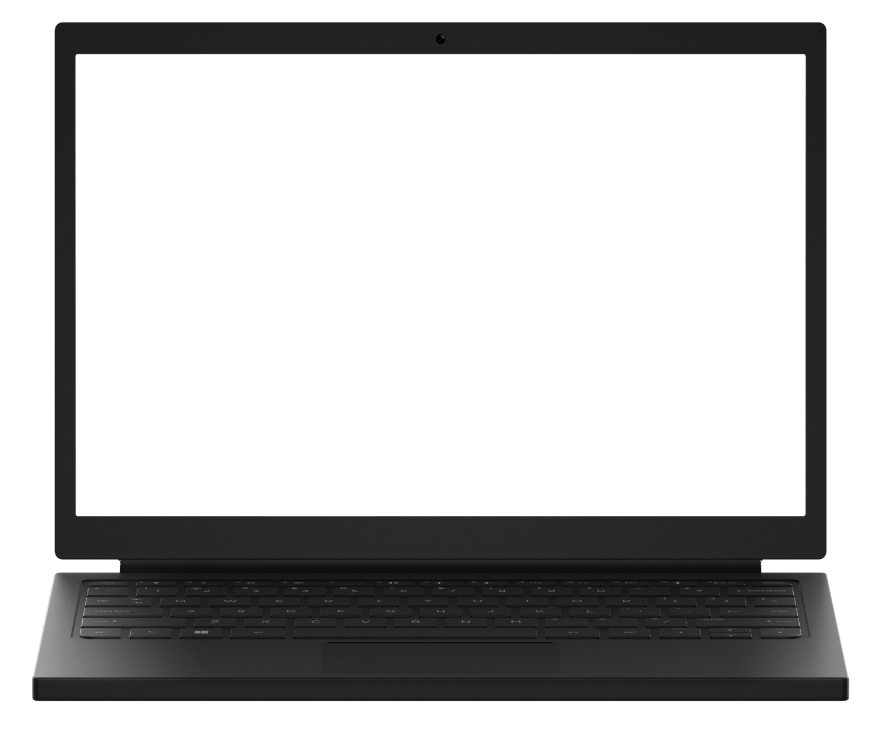
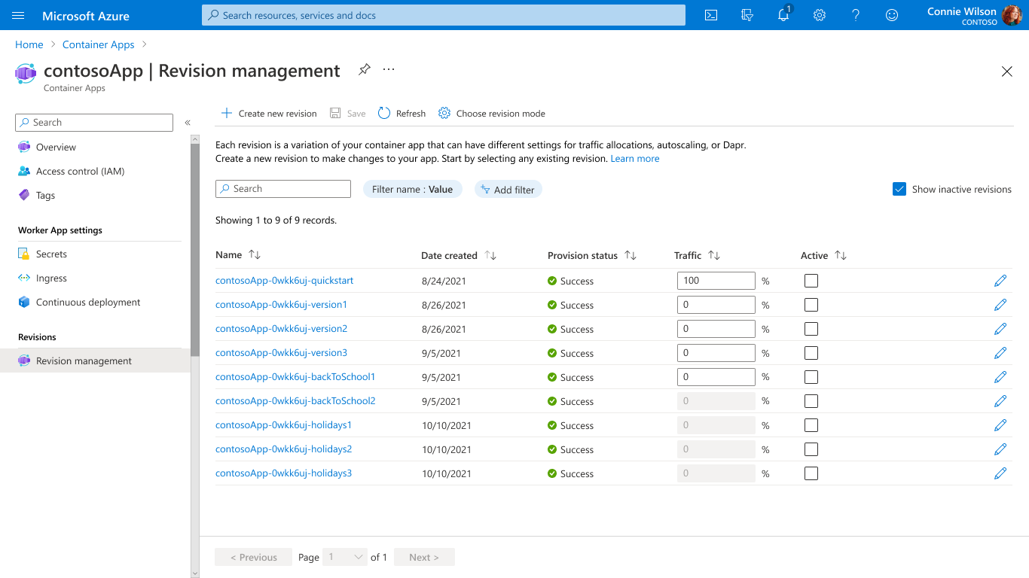
Build modern apps on open-source
Focus on apps, not infrastructure
Scale dynamically based on events
Build modern apps on open-source
→
App portability powered by open standards and APIs
App patterns and best practices encapsulated by products like Dapr
Service capabilities influenced by OSS contributions
→
→
Notes:
Container Apps is built on great open-source technology. It runs on top of Azure Kubernetes Service, KEDA, Dapr, and Envoy.
Since Container Apps is built-on top of AKS, KEDA, Envoy and Dapr, it allows you to take advantage of the capabilities of those platforms, such as built-in service discovery for microservices, fully managed HTTP and HTTP/2 ingress endpoints, etc. since they’re built in. This also gives us the advantage of being able to perform application lifecycle tasks such as upgrades, traffic shifting and versioning in a much simpler way than we would if we were managing the orchestrator infrastructure ourselves.

Slide 9
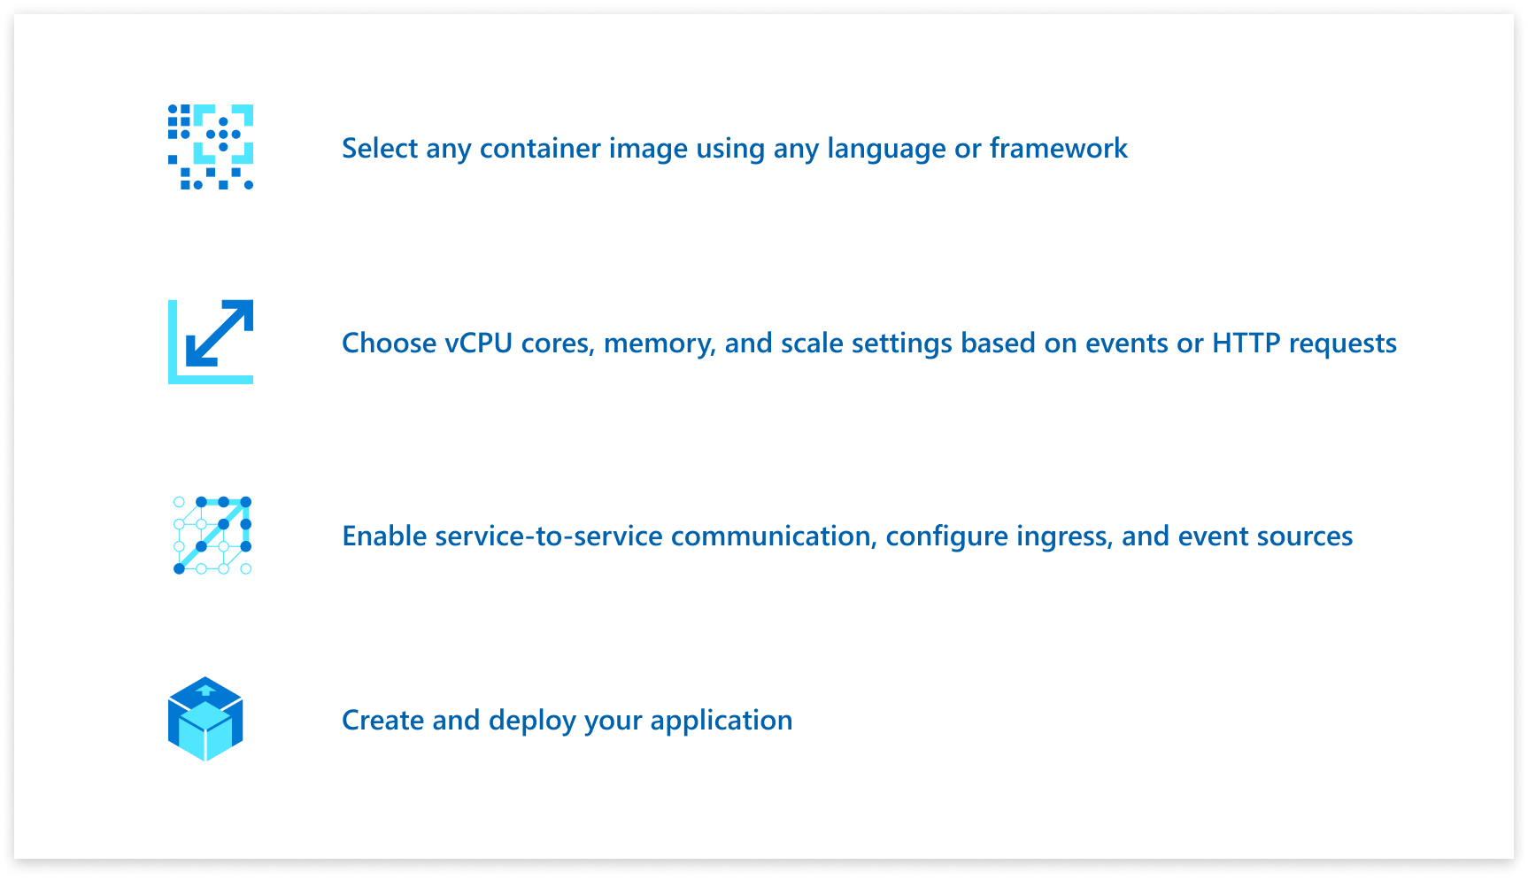
Build modern apps on open source
Focus on apps, not infrastructure
Scale dynamically based on events
Focus on apps, not infrastructure
→
Apps with any development stack, any Linux container image
No required programming model
High productivity development experience
→
→
Notes:
Because you’re not burdened by managing a container orchestrator, this gives you more time to focus on building your applications. With Container Apps, you can build microservices, APIs, event processing workers, and background jobs using containers and any programming language or framework and easy code-to-cloud pipeline using GitHub Actions.
Those of you who are coming from a Functions background, Container Apps provides us with more flexibility, since there’s no enforcement of a programming model and there are no limitations around languages. However, for those of you looking to deploy Windows Containers to Container Apps, that’s no possible (When or If it will be available, I can’t say).
Through the built-in integration with Distributed Application Runtime (Dapr), you can simplify common tasks like event processing, pub/sub, service invocation, and more.

Slide 10
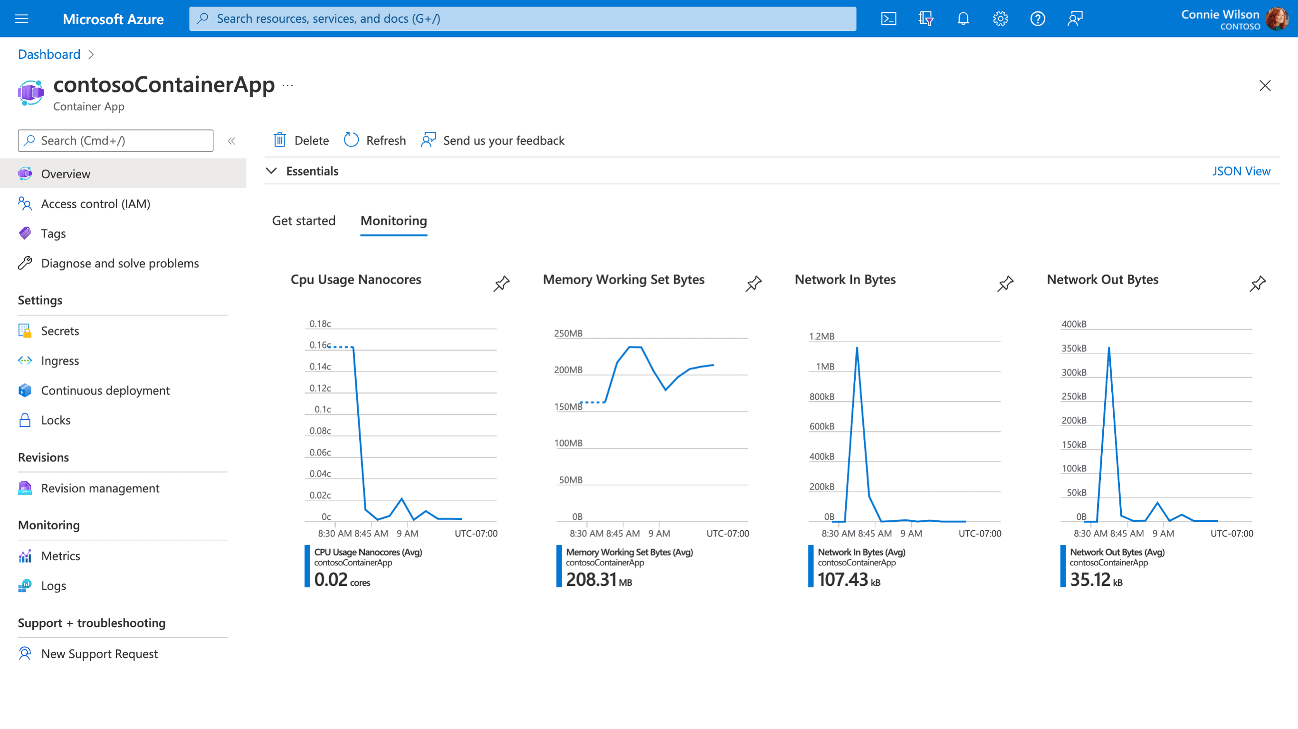
Build modern apps on open source
Focus on apps, not infrastructure
Scale dynamically based on events
Scale dynamically based on events
→
Serverless autoscale based on HTTP requests, KEDA event scale triggers, or CPU and Memory
Declarative scaling rules eliminate the need to manage complex infrastructure
Scale to 0 and pay per use by second
→
→
Notes:
Container Apps is the only serverless container solution offering a combination of robust built-in HTTP-based auto-scaling (including scale to zero), and event-driven auto-scale to run containers that may be processing messages from queues, streams, or databases.
You can run containers and scale in response to HTTP traffic or a growing list of KEDA-supported scale triggers including Azure Event Hub, Apache Kafka, RabbitMQ Queue, MongoDB, MySQL, and PostgreSQL. Scale to zero and pay for only what you use, by the second.

Slide 11
What can we build with Container Apps?

Slide 12
What can you build with Azure Container Apps?
Public API endpoints
Web
Apps
Event-driven processing
Background processing
Microservices
MICROSERVICE A
MICROSERVICE B
HTTP TRAFFIC
MICROSERVICE C
80%
20%
REVISION 1
REVISION 2
Microservices architecture with the option to integrate with Dapr
E.g., API app with HTTP requests split between two revisions of the app
E.g., Web app with custom domain, TLS certificates, and integrated authentication
E.g., Queue reader app that processes messages as they arrive in a queue
E.g., Continuously running background process transforms data in a database
AUTO-SCALE CRITERIA
Individual microservices can
scale independently using any KEDA scale triggers
Scaling is determined by the number of concurrent HTTP requests
Scaling is determined by the number of concurrent HTTP requests
Scaling is determined by the number of messages in the queue
Scaling is determined by the level of CPU or memory load
Notes:
You may be wondering what sort of applications can you build with Azure Container Apps?
Here are some common ones including:
Deploying API endpoints
Hosting background processing applications
Handling event-driven processing
Running microservices
With each of those applications, you can dynamically scale based on:
HTTP traffic
Event-driven processing
CPU or memory load
Any KEDA-supported scaler

Slide 13
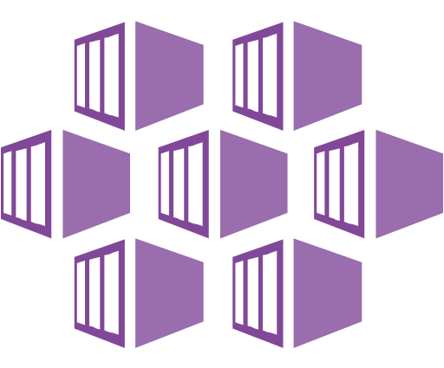
How does ACA compare to AKS?
Azure Kubernetes Service (AKS)
Azure Container Apps (ACA)
Infrastructure focus, higher flexibility
Application focus, infrastructure abstraction
Managed Kubernetes cluster in Azure with full access to the Kubernetes API server and high level of control over cluster configuration with a node-based pricing model
Fully-managed serverless abstraction on top of Kubernetes infrastructure, purpose built for managing and scaling event-driven microservices with a consumption-based pricing model
Core value proposition
Upstream feature parity with a managed control plane
Operations flexibility with advanced customization
Experienced Kubernetes operators
Platform-as-a-Service experience with serverless scale
Developer productivity with low operations overhead
Linux-based, general-purpose stateless containers
Optimized for
Operators deploy node-based AKS clusters using Azure Portal, CLI or Infrastructure-as-Code templates (IaC)
Developers deploy containers via Kubernetes deployment manifests or HELM charts to logically-isolated namespaces within the cluster
Developers deploy containers as individual Container Apps using Azure Portal, CLI or IaC templates without any Kubernetes manifests required
Related container apps are deployed to a shared Container Apps environment comparable to a Kubernetes namespace
Interaction model
Provides a set of cluster extensions and add-ons for operators to enable OSS components in-cluster including Dapr, KEDA, Open Service Mesh, GitOps (Flux), Pod Identity, etc.
Supports manual installation via Kubernetes manifests
Includes opinionated platform capabilities powered by CNCF projects including Dapr, KEDA and Envoy which are fully platform-managed and supported
Envoy: managed ingress and traffic splitting
KEDA: managed, event-driven autoscale
Dapr: codified best practices for microservices
OSS Integration
Notes:
The main focus here is flexibility vs productivity.
This talk is in NO WAY attempting those who use and love AKS today to make them move to Azure Container Apps.
The value prop for ACA is that if you love working with containers, but rather not have to deal with managing the underlying infrastructure, or you don’t want to take the time to learn Kubernetes, Container Apps is a great option.
Cool, so that’s the high level overview of Container Apps. Let’s dive a little deeper.

Slide 14
Let’s dive a little deeper

Slide 15
Environments
Environment (virtual network boundary)
Container app 1
Revision 1
Revision 2
Replica
Replica
Environments define an isolation and observability boundary around a collection of container apps deployed in the same virtual network
Container(s)
Container(s)
Container app 2
Revision 1
Revision 2
Replica
Replica
Container(s)
Container(s)
Notes:
Individual container apps are deployed to a single Container Apps environment, which acts as a secure boundary around groups of container apps. Container Apps in the same environment are deployed in the same virtual network and write logs to the same Log Analytics workspace.
Container Apps in the same environment are deployed in the same virtual network and write logs to the same Log Analytics workspace.
When you provision a Container App Environment, a VNET which acts a boundary is deployed along with it, which lives in Microsoft’s tenant. You can also provide an existing virtual network in your subscription when you create an environment
Reasons to deploy container apps to the same environment include situations when you need to:
Manage related services
Deploy different applications to the same virtual network
Have applications communicate with each other using Dapr
Have applications to share the same Dapr configuration
Have applications share the same log analytics workspace
Reasons to deploy container apps to different environments include situations when you want to ensure:
Two applications never share the same compute resources
Two applications can't communicate with each other via Dapr

Slide 16
Container Apps
Environment (virtual network boundary)
Container app 1
Revision 1
Revision 2
Replica
Replica
A Container App hosts a single, independent microservice and includes its desired state configuration
Container(s)
Container(s)
Container app 2
Revision 1
Revision 2
Replica
Replica
Container(s)
Container(s)
Notes:
A single container app hosts a single services which includes the desired state configuration.

Slide 17
Containers
Environment (virtual network boundary)
Container app 1
Revision 1
Revision 2
Replica
Replica
Replica
Replica
Containers in Azure Container Apps can use any development stack of your choice
Container(s)
Container(s)
Container(s)
Container(s)
Container app 2
Revision 1
Revision 2
Replica
Replica
Container(s)
Container(s)
Notes:
Azure Container Apps manages the details of Kubernetes and container orchestrations for you. Containers in Azure Container Apps can use any runtime, programming language, or development stack of your choice.
Azure Container Apps supports:
Any Linux-based container image
Containers from any public or private container registry
However, Azure Container Apps can't run privileged containers or processes that requires root access.
Additional features include:
There is no required base container image.
If a container crashes, it automatically restarts thanks to the power of Kubernetes under the hood.
You can define multiple containers to run together in container apps that will be collocated and scale together. This is not for running multiple microservices in a single container app, but more for providing support for sidecar containers alongside your core workload container.
Reasons to run containers together may include:
Use a container as a sidecar to your primary app.
Share scale rules among containers.
Group together multiple containers that need to be co-located on the infrastructure.
Enable direct communication among containers on the same host.

Slide 18
Container App quotas
Feature | Scope | Default | Notes
Environments | Region | Up to 15 | Can deploy 15 env x 3 regions = 45 total per subscription
Container Apps | Environment | Unlimited!
Revisions | Container App | Up to 100
Replicas | Revision | 300
Notes:
It’s important to have an understanding of quotas.
They can change quite often, but depending on what you’re building, it can influence the design of your architecture.
Let’s explore some implementations you could take with multitenancy architectures

Slide 19
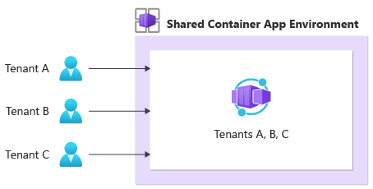
Multitenancy Patterns: Share all the things!
All tenants share resources in Container App environment.
Cost-efficient, less overhead.
Application must have multitenancy awareness.
No data or network isolation
Noisy neighbor concerns.
Notes:
Let’s say your building a SaaS produce that uses Container Apps as the platform, you could share your Container App environment amongst all your tenants.
Less overhead and cost-efficient
However, application code must have multitenancy awareness
No data or network isolation
Can suffer noisy neighbor concerns if one tenant requires more resources than others.

Slide 20
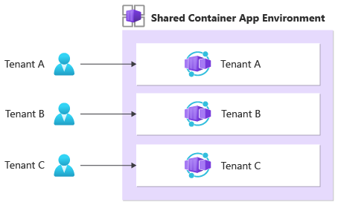
Multitenancy Patterns: You get an app, you get an app
Cost efficient at the environment level.
Separation of app deployments and upgrades.
Resource isolation at Container App level.
Ensure Dapr components are scoped correctly!
Notes:
You can have one environment, and deploy an app per tenant.
Good example of something you CAN do, but probably SHOULDN’T do.
Defeats the purpose of the microservices architecture that Container Apps was designed for.
You do have one environment, you can separate your app deployments and upgrades more effectively, and noisy neighbor issues can be resolved with resource isolation at the app level.
You will need to ensure that the resources your tenant needs (Dapr components, databases, message brokers) are scoped correctly.

Slide 21
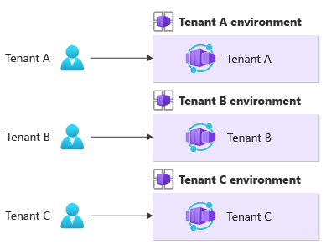
Multitenancy Patterns: This is my environment, there are many like it….
Compute and network isolation at environment level.
Applications don’t need to be multitenancy aware.
Limits on environments per region.
Total Cost of Ownership and deployment complexity can increase!
Notes:
Finally you can provision an environment per tenant.
This will give you compute and network isolation for each tenant,
Removes the need for your apps to be multitenancy aware.
However, there are limits on how many environments you provision per region and deployment complexity can increase. (Use Deployment Stamps to help you with this)

Slide 22
Revisions
Environment (virtual network boundary)
Container app 1
Multi-revision mode
Revision 1
Revision 2
Replica
Replica
Revisions are immutable version snapshots of a container app
Container(s)
Container(s)
Container app 2
Single-revision mode
Revision 1
Replica
Container(s)
Notes:
A revision is an immutable snapshot of a container app. A container app can run in either single-revision mode, which is the default… or multiple revision mode
For example for Container App 1:
The first revision is automatically created when you deploy your container app.
New revisions are automatically created when a container app's template configuration changes which includes things like the container image, environment variables, cpu and memory allocation, etc.
While revisions are immutable, they're affected by changes to global configuration values, which apply to all revisions. Think things like secrets, dapr settings, etc.
Revisions are most useful when you enable ingress to make your container app accessible via HTTP. Revisions are often used when you want to direct traffic from one snapshot of your container app to the next. Typical traffic direction strategies include A/B testing and BlueGreen deployment.

Slide 23
Revision-scope vs Application-scope changes
Revision-scope change is any change to the template of the container app
Includes:
Revision suffix changes
Container configuration and image changes
Scale rules for the container
Application-scope changes are changes to the configuration of the container app.
Includes:
Secret values
Revision mode
Ingress configuration
Dapr Settings
Credentials for private container registries.

Slide 24
Revision Mode
Single revision
Multiple revisions
Only one revision is active at a time
The latest version replaces the active revision
Can run multiple revisions of your app simultaneously.
Use revision labels to direct traffic to specific revisions.
Revisions remain active until we deactivate them

Slide 25
Replicas
Environment (virtual network boundary)
Container app 1
Revision 1
Revision 2
Replica
Replica
Replicas are the unit of scale in container apps, with the default replica count being 0
Container(s)
Container(s)
Container app 2
Revision 1
Revision 2
Replica
Replica
Container(s)
Container(s)
Notes:
The unit of scale is called a replica. When running in multiple revision mode, keep in mind that each revision can have it’s own scale rules. This means you could have 10 instances of container app 1 revision 1 running, and only 5 of container app 1 revision 2 based on it’s own scale criteria.

Slide 26
Replicas
Environment (virtual network boundary)
Container app 1
Revision 1
Revision 2
Replica
Replica
Replicas are the unit of scale in container apps, with the default replica count being 0
Container(s)
Container(s)
Container app 2
Revision 1
Revision 2
Replica
Replica
Container(s)
Container(s)
Notes:
The unit of scale is called a replica. When running in multiple revision mode, keep in mind that each revision can have it’s own scale rules. This means you could have 10 instances of container app 1 revision 1 running, and only 5 of container app 1 revision 2 based on it’s own scale criteria.

Slide 27





Application autoscaling made simple Open-source, extensible, and vendor agnostic
Metrics Adapter | Controller | Scaler
Intelligently scale your event-driven applications
Out-of-the-box scalers for various vendors, databases, messaging systems, telemetry systems, CI/CD, and more
Event-driven
Built-in scalers
Kubernetes-based Event Driven Autoscaler
Support for triggers across variety of cloud providers & products
Bring rich scaling to every workload
Vendor-agnostic
Rich capabilities
Drive the scaling of any container based on a growing list of 35+ event sources, known as: scalers
keda.sh

Slide 28
Scaling
KEDA
HTTP
Event-driven
CPU
Memory
{
"name": "http-rule",
"http": {
"metadata": {
"concurrentRequests": 50
}
}
}
artemis-queue, kafka, aws-cloudwatch, aws-kinesis-stream, aws-sqs-queue, azure-blob, azure-eventhub, azure-servicebus, azure-queue, cron, external, gcp-pubsub, huawei-cloudeye, ibmmq, influxdb, mongodb, mssql, mysql, postgresql, rabbitmq, redis, redis-streams, selenium-grid, solace-event-queue, ..
{
"name": "cpu-rule",
"custom": {
"type": "cpu",
"metadata": {
"type": "Utilization",
"value": "50"
}
}
}
{
"name": "mem-rule",
"custom": {
"type": "memory",
"metadata": {
"type": "AverageValue",
"value": "512"
}
}
}
Support for scale to zero and specifying minimum/maximum replicas
Support for specifying minimum/maximum replicas
Notes:
When it comes to scaling, you have a number of choices here, some of which support scaling to zero.
Both HTTP scaling and Event-driven scaling support scaling to zero when there are no requests, or when there are no events to process.
HTTP scaling
With an HTTP scaling rule, you have control over the threshold that determines when to scale out. You define the maximum number of concurrent requests. Once the number of requests exceeds this value, then more replicas are added, up to the maxReplicas amount.
Event-driven scaling
Container Apps can scale based of a wide variety of event types. Any event supported by KEDA, is supported in Container Apps. Examples include: …
CPU scaling
CPU scaling allows your app to scale in or out depending on how much the CPU is being used utilizing the KEDA CPU scale trigger.
Memory scaling
Memory scaling allows your app to scale in or out depending on how much memory is being used utilizing the KEDA Memory scaler
You also have a choice to set a minimum number of instances that will always be up and running. Those will then be charged at a reduced “Idle” rate as long as those applications are not processing requests.

Slide 29
Networking Architecture
External Environments
Internal Environments
Container Apps available for public requests.
Environments deployed with a virtual IP on a public, external IP address.
No public endpoint.
Deployed with a virtual IP mapped to an internal IP address.
Internal endpoint is an Azure Internal Load Balancer.
IP Addresses are issued from custom Vnet’s list of private IPs.
Notes:
Azure Container Apps run in a Container App Environment. These are support by a Virtual Network. When you create an environment, you can provide a custom Vnet, otherwise a VNET is automatically created for you.
The VNET that is created for you is created in our tenant, so you’re not able to access them. So if you need to take full control over your VNET, you should provide your own existing VNET.
(Describe table).

Slide 30
Ingress
Environment (virtual network boundary)
Container app 1
Revision 1
Revision 2
Replica
Replica
Replica
Replica
Internal or external visibility with TLS termination and support for HTTP/1.1 and HTTP/2
Container(s)
Container(s)
Container(s)
Container(s)
80%
20%
Ingress
Notes:
Azure Container Apps allows you to expose your container app to the public web by enabling ingress. When you enable ingress, you do not need to create an Azure Load Balancer, public IP address, or any other Azure resources to enable incoming HTTPS requests.
With ingress enabled, your container app features the following characteristics:
Supports TLS termination
Supports HTTP/1.1 and HTTP/2
Endpoints always use TLS 1.2, terminated at the ingress point
Endpoints always expose ports 80 (for HTTP) and 443 (for HTTPS).
By default, HTTP requests to port 80 are automatically redirected to HTTPS on 443.
Your ingress IP and fully qualified domain name can either be visible externally to the internet, or internally within a VNET. With ingress enabled, your application is assigned a fully qualified domain name (FQDN).
Your Container Apps environment has a single public IP address for applications with external ingress visibility, and a single internal IP address for applications with internal ingress visibility. Therefore, all applications within a Container Apps environment with external ingress visibility share a single public IP address. Similarly, all applications within a Container Apps environment with internal ingress visibility share a single internal IP address. HTTP traffic is routed to individual applications based on the FQDN in the host header.

Slide 31
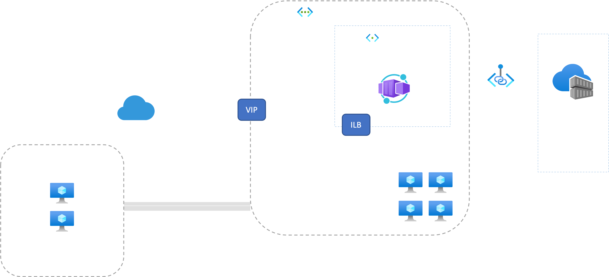
Bring your own Virtual Network
Deploy an environment using a custom virtual network and optionally without a public IP address
Notes:
Now just to talk about situations where you would use a custom VNET, it’s important to keep the following in mind:
If you want your container app to restrict all access from outside, you should create an internal environment.
When you provide your own VNET, you need to provide a subnet that is dedicated to the Container App environment that you deploy. This subnet can’t be used by other services.
The Network addresses are assigned from a subnet range you define as the environment is created:
You can define the subnet range used by the Container Apps environment.
Once the environment is created, the subnet range is immutable,
Each revision is assigned an IP address in the subnet.

Slide 32

Logging
Environment
Container app 1
Revision 1
Revision 2
Replica
Replica
Containers write logs to standard output or standard error streams surfaced via Log Analytics
Container(s)
Container(s)
stderr/stdout
stderr/stdout
Log Analytics
Notes:
Container Apps provides several built-in observability features that gives us a holistic overview of your container app’s health throughout the application lifecycle, which helps us monitor and diagnose the state of our applications.
Now we have different ways of monitoring our Container Apps throughout the development lifecycle. We can access our container logs in real time through log streaming and connecting to the container console during the dev/test phase. Once we deploy our container apps into our production environments, we can use Azure Monitor to analyze metrics, receive alerts for critical conditions and view application logs using Log Analytics.

Slide 33
Secrets management
"template": {
"containers": [
{
"image": "myregistry/myQueueApp:v1",
"name": "myQueueApp",
"env": [
{
"name": "QueueName",
"value": "myqueue"
},
{
"name": "ConnectionString",
"secretref": "queue-connection-string"
}
]
}
],
}
Securely store sensitive configuration elements that are then available to containers through environment variables, scale rules, and Dapr
Notes:
Azure Container Apps allows your application to securely store sensitive configuration values. Once defined at the application level, secured values are available to containers, inside scale rules, and via Dapr.
Secrets are scoped to an application, outside of any specific revision of an application.
Adding, removing, or changing secrets does not generate new revisions.
Each application revision can reference one or more secrets.
Multiple revisions can reference the same secret(s).
When a secret is updated or deleted, you can respond to changes in one of two ways:
Deploy a new revision.
Restart an existing revision.

Slide 34
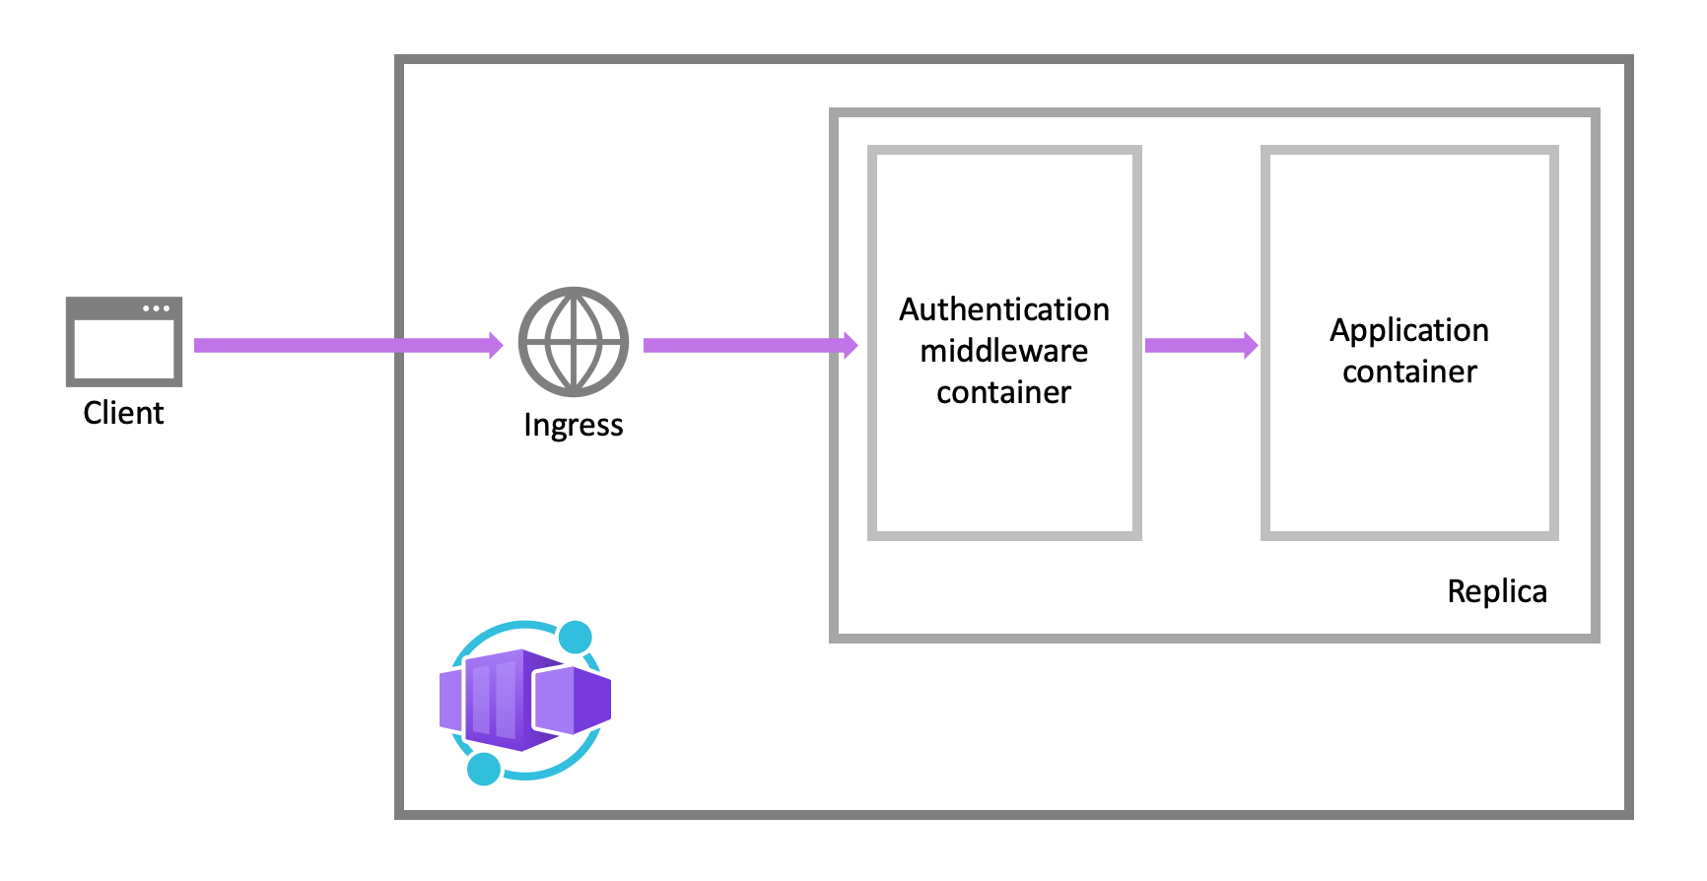
Authentication
Built-in Authentication capabilities available (EasyAuth)
Runs as a sidecar for each replica.
Can use popular identity providers and any OpenID Connect provider.
Notes:
Container Apps comes with EasyAuth.
Uses federated identity, so you can use identity providers such as Microsoft Identity, GitHub or any OpenID Connect provider.
The authentication and authorization middleware component runs as a sidecar for each replica of your app.
Every incoming HTTP request passes through the security layer before being handled by your application
So middleware handles:
Authentication of users and clients
Manages the authenticated session
Injects identity information into HTTP request headers

Slide 35


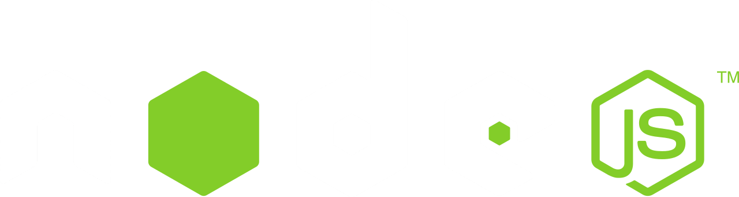

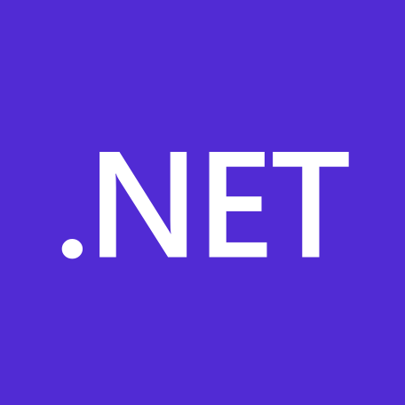

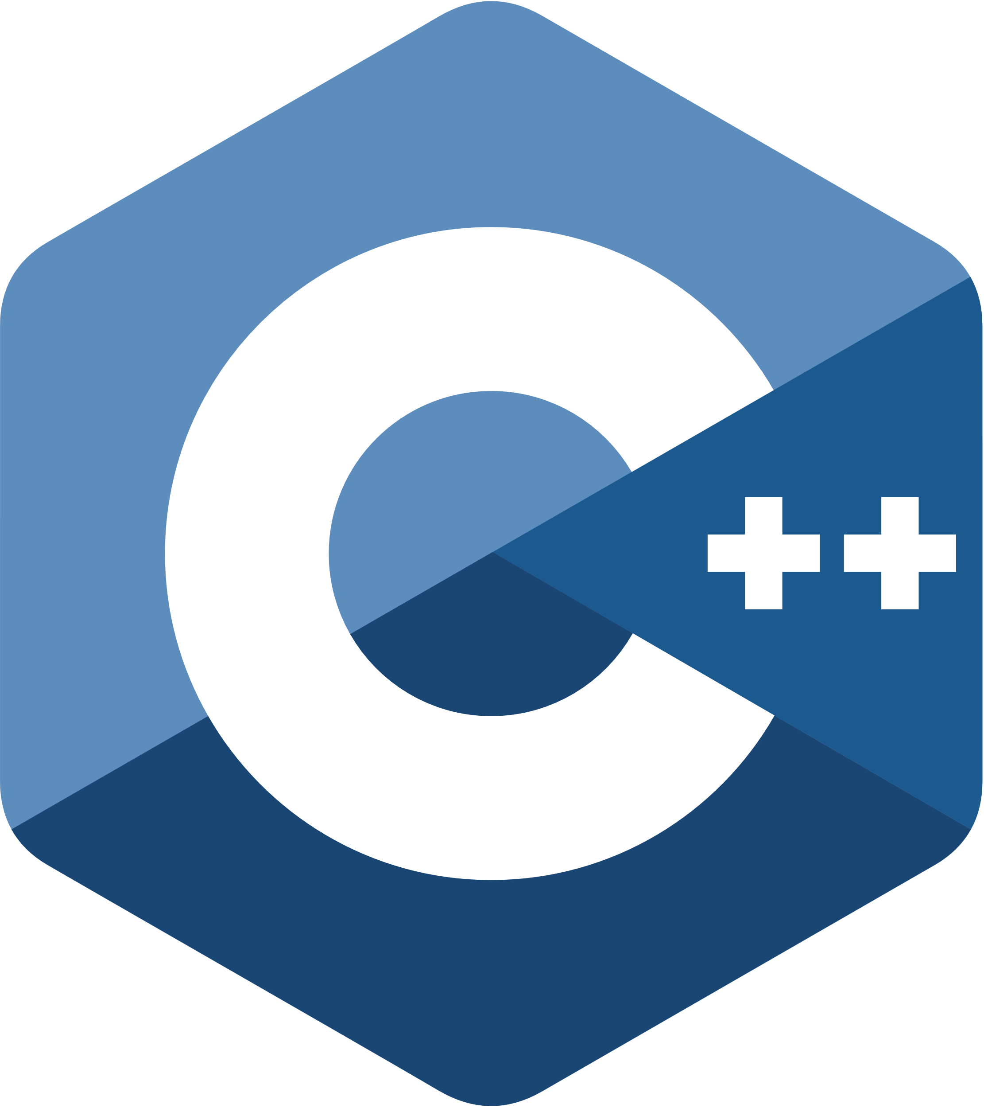
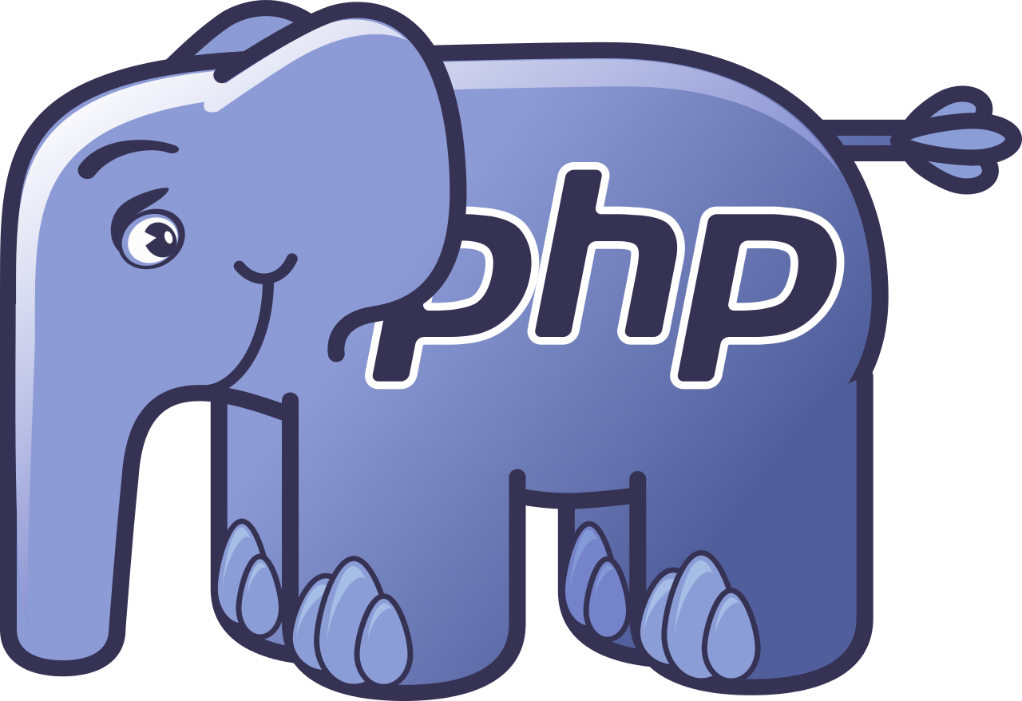







Microservices using any language or framework Any cloud or edge infrastructure
Application code
Microsoft services written in any code or framework
Distributed Application Runtime
HTTP API
gRPCz API
Service-to-service invocation
State management
Publish and subscribe
Resource bindings and triggers
Actors
Observability
Secrets
Extensible
Portable, event-driven, runtime for building distributed applications across cloud and edge
Hosting infrastructure
dapr.io
Azure Arc
On-premises
Notes:
Building microservices and distributed application is hard.
Dapr helps developers build event-driven, resilient distributed applications. Whether on-premises, in the cloud, or on an edge device, Dapr helps you tackle the challenges that come with building microservices and keeps your code platform agnostic.
Dapr is a set of APIs that makes it easy for you to write distributed applications. It runs as a sidecar process next to an application, whether on Kubernetes or any other environment, and gives you a set of primitives in the form of pub/sub, state management, secrets management, event triggers, and service-to-service calls that are secured and reliable. With Dapr, developers focus on building business logic instead of infrastructure.
The project was created in 2019 at Microsoft. Over time, many community members have joined and contributed to the project, extending it and helping it reach a stable 1.0 release in February 2021. Today, the Dapr Steering and Technical Committee governs the project with representatives from Alibaba, Intel, and Microsoft. And in November 2021, Dapr joined the Cloud Native Computing Foundation as an incubating project.

Slide 36

Enough talk! Demos!
https://github.com/willvelida/aca-productstore
Notes:
Now, let me show you how this works in action

Slide 37
Recap
Kubernetes without the Kubernetes!
Use Revisions to manage lifecycle application.
Built in-observability.
Opinionated OSS integration:
Support for Dapr Framework
Scaling capabilities with KEDA
Service Discovery with Envoy.
Notes:
Container apps helps developers shift their focus from having to maintain complicated container orchestrators and focus on their applications.
This helps us as developers to perform application lifecycle tasks such as upgrades, traffic shifting and versioning in a much simpler way than we would if we were managing the orchestrator infrastructure ourselves.
Container Apps comes with buil-in obseravibility with Azure Monitor today. More integrations are coming.
Can use internal and external environments. Can bring our own VNET
ACA provides support and capabilities from the Open Source world.

Slide 38
Want to learn more?
https://learn.microsoft.com/en-us/azure/container-apps/
https://learn.microsoft.com/en-us/azure/container-apps/samples
https://github.com/willvelida/aca-productstore
https://github.com/Azure/aca-dotnet-workshop
https://dapr.io/
https://keda.sh/

Slide 39
@willvelida | willvelida@microsoft.com
Notes:
Thanks for listening!
If you have any questions, reach out to me on @willvelida on twitter or willvelida@microsoft.com

